Slide 1

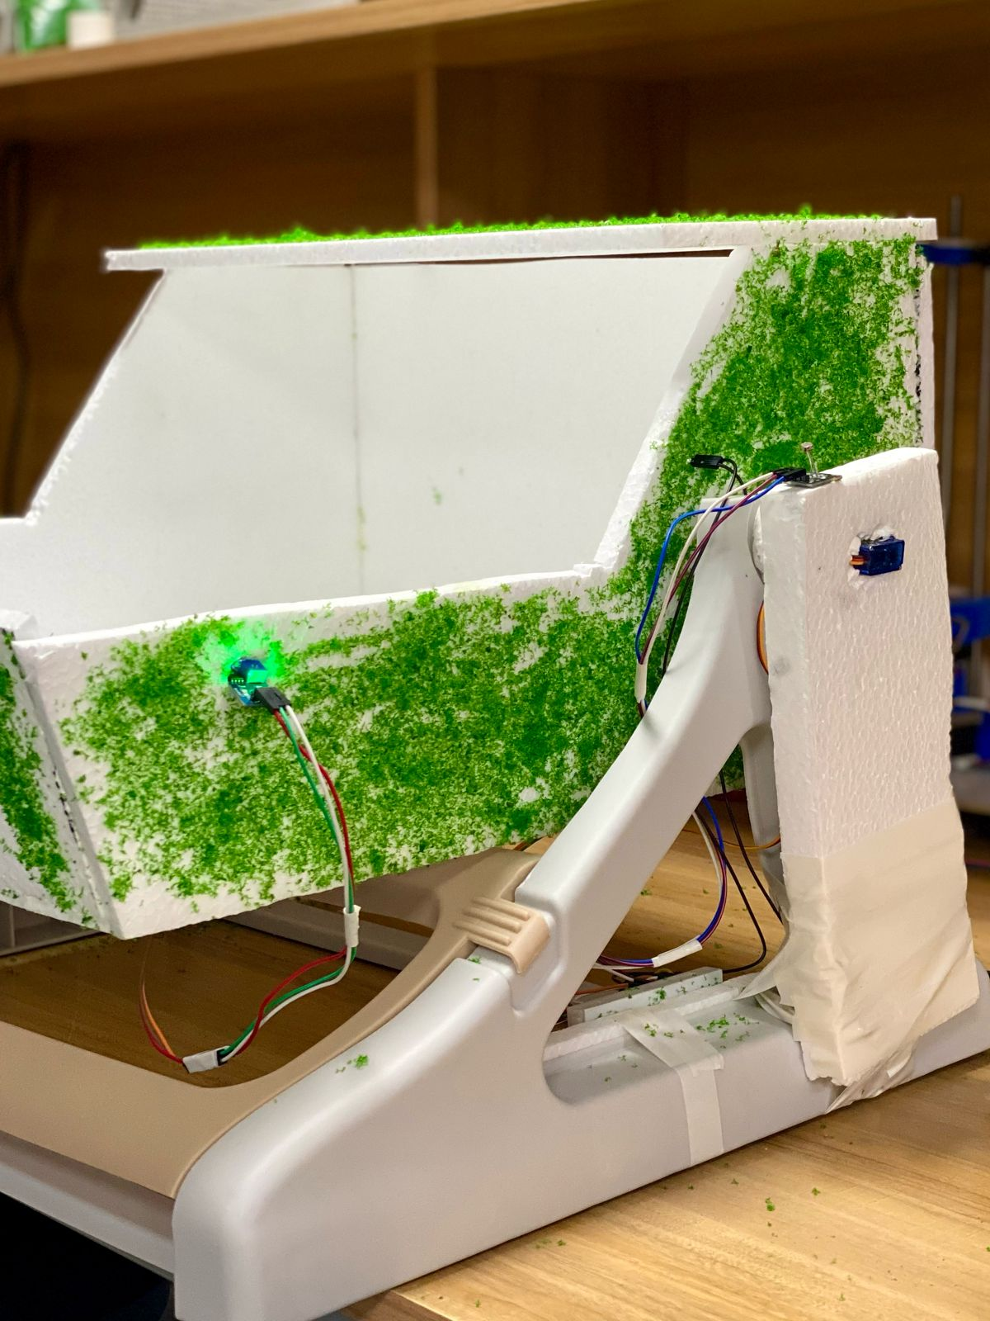
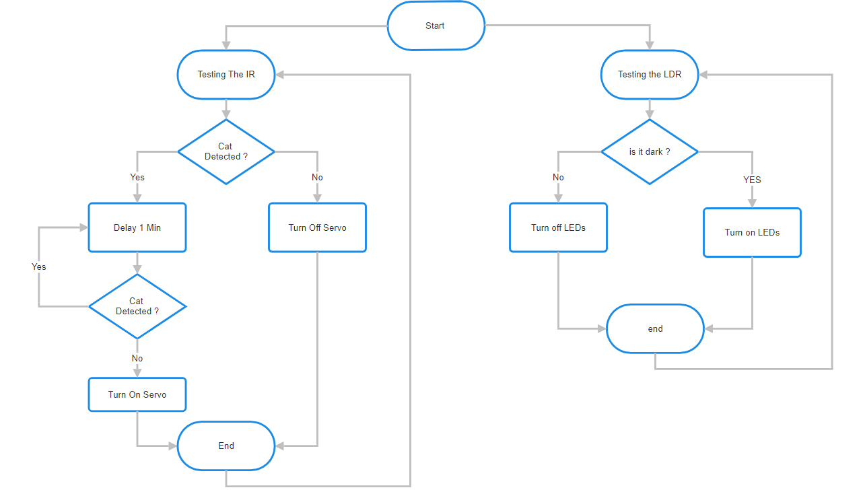
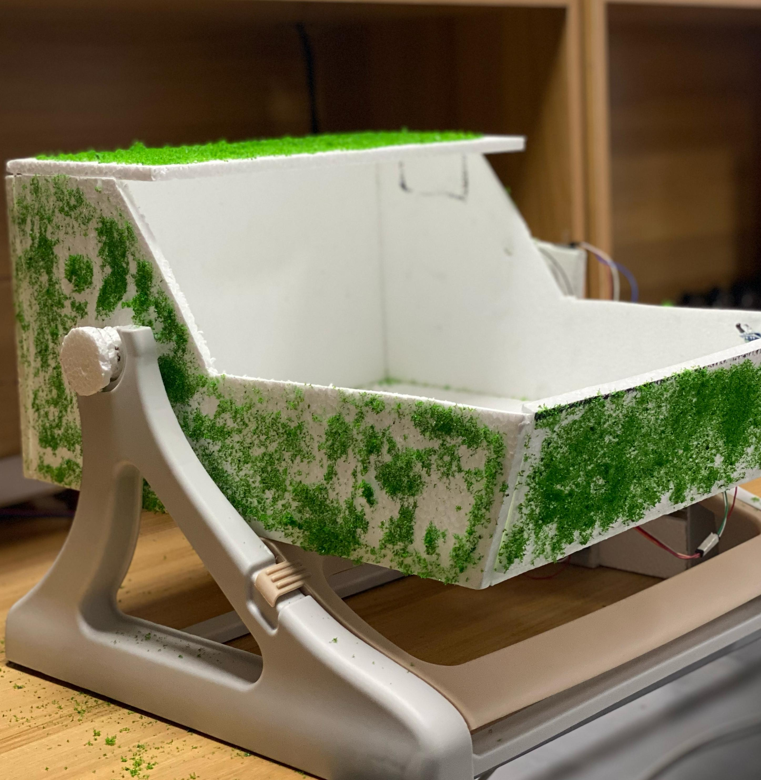
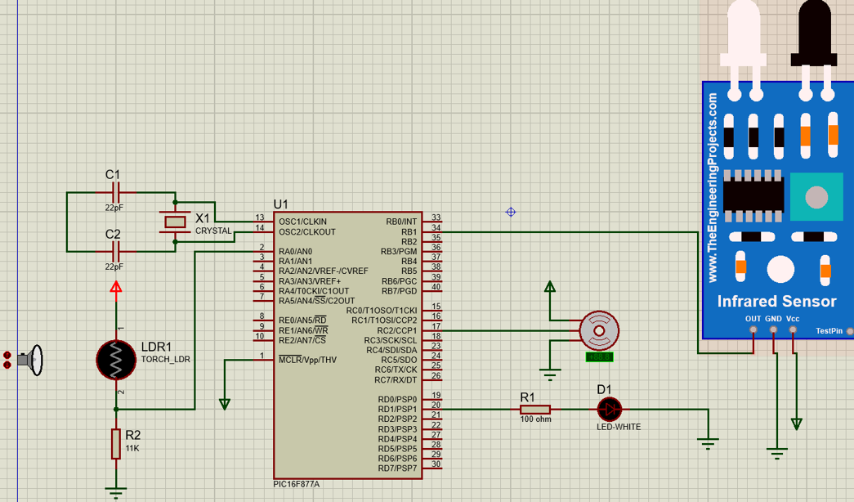
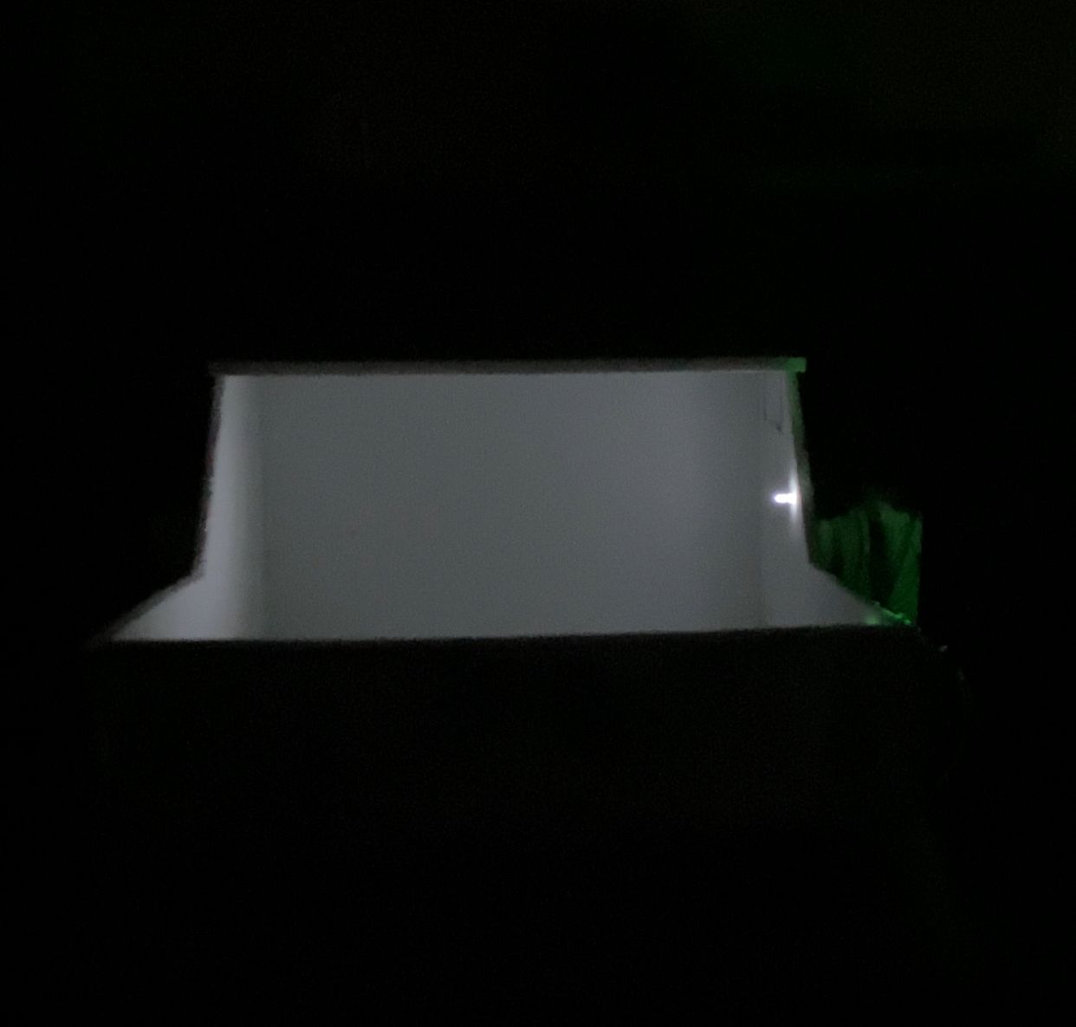
Smart Litter Box
S. Sakkijha, H. Alrwashdeh, and H.Altoubasy
Supervisor: Dr. Bilal Sababha, Dr. Anastassia Gharib
Embedded Systems Final Design Project, Spring 2024
King Abdullah II School of Engineering
Princess Sumaya University for Technology
Introduction
This project develops a self-cleaning cat litter box using sensor technology and mechanical automation. An infrared sensor monitors when a cat enters and exits the box. Once the cat leaves, a servo motor activates, sifting the litter through a filter to separate waste from clean litter. The waste is deposited into a compartment, and the litter box resets for the next use.
By integrating embedded systems, sensor technology, and mechanical design, this project aims to automate and simplify pet care. The litter box reduces manual cleaning effort and maintains a consistently hygienic environment for cats. The objective is to showcase how advanced technologies can create practical and efficient pet care solutions.
Results
After putting in effort on both the coding and the physical prototype, we were finally able to accomplish the objective of this project, which was to be able to automate the cleaning of litter box.
Figure 4: Final result.
Figure 4.1: Project shown from side.
Figure 4.1: Project shown in dark.
LED
LDR sensor
IR Sensor
Servo motor
Design
For our first step, we created a flowchart that would later come to represent the underlying software
Figure 1: software design.
For the LDR it keeps testing, if it is dark the connected LEDs will turn on, if not the LEDs will be off.
For the IR sensor, it will keep testing for the presence of the cat, if there is a cat inside the box it will turn off the servo. Otherwise it will start a 1 minute delay, and reassure that the box is empty, then the servo will be turned on.
Figure 2 electrical Design.
Conclusion
In conclusion, our project has successfully demonstrated the integration of advanced technologies to create an efficient and convenient solution for cat owners. By combining an IR sensor for cat detection, a servo motor for automated cleaning, and an LDR sensor for ambient light control, we have developed a self-cleaning litter box that significantly reduces the manual effort required for cleaning.
Through this project, we have showcased the potential of robotics, sensor technology, and automation in addressing everyday challenges, ultimately improving the quality of life for both pets and their human companions.

